Slide 1






SENIOR DESIGN PRESENTATION TEAM 15
ZENING CHEN
CREATIVE INNOVATOR
RAGHAV GANDHI
TECHNICAL LEADER
PAULO MESAROS
LOGISTICS MANAGER
JIANXING WAN
GENERAL SUPPORT
MARCOS ZATKULAK
PROJECT MANAGER
Client Team:
Christine Sorensen, CEO
Jeff Newman, VP of Client Services
Jeff Shelly, Facilities Manager
Purdue Resources:
Cluster Leader: Mr. Gaurav Nanda
Technical Advisor: Dr. Brandon Pitts

Slide 2
CONTENTS
PROJECT STATEMENT
PROJECT BACKGROUND
APPROACH AND RESULTS
PROJECT MANAGEMENT
RECOMMENDATION AND CONCLUSION
APPENDIX

Slide 3
PROJECT STATEMENT
Notes:
Marcos

Slide 4
PROJECT STATEMENT
As a team, we were able to accomplish the following:
Create unique new jobs
Help Janus enter a completely new sector
Ensure sustainability of the venture
Build meaningful relationships between Janus and both ourselves and Purdue
Notes:
Marcos

Slide 5
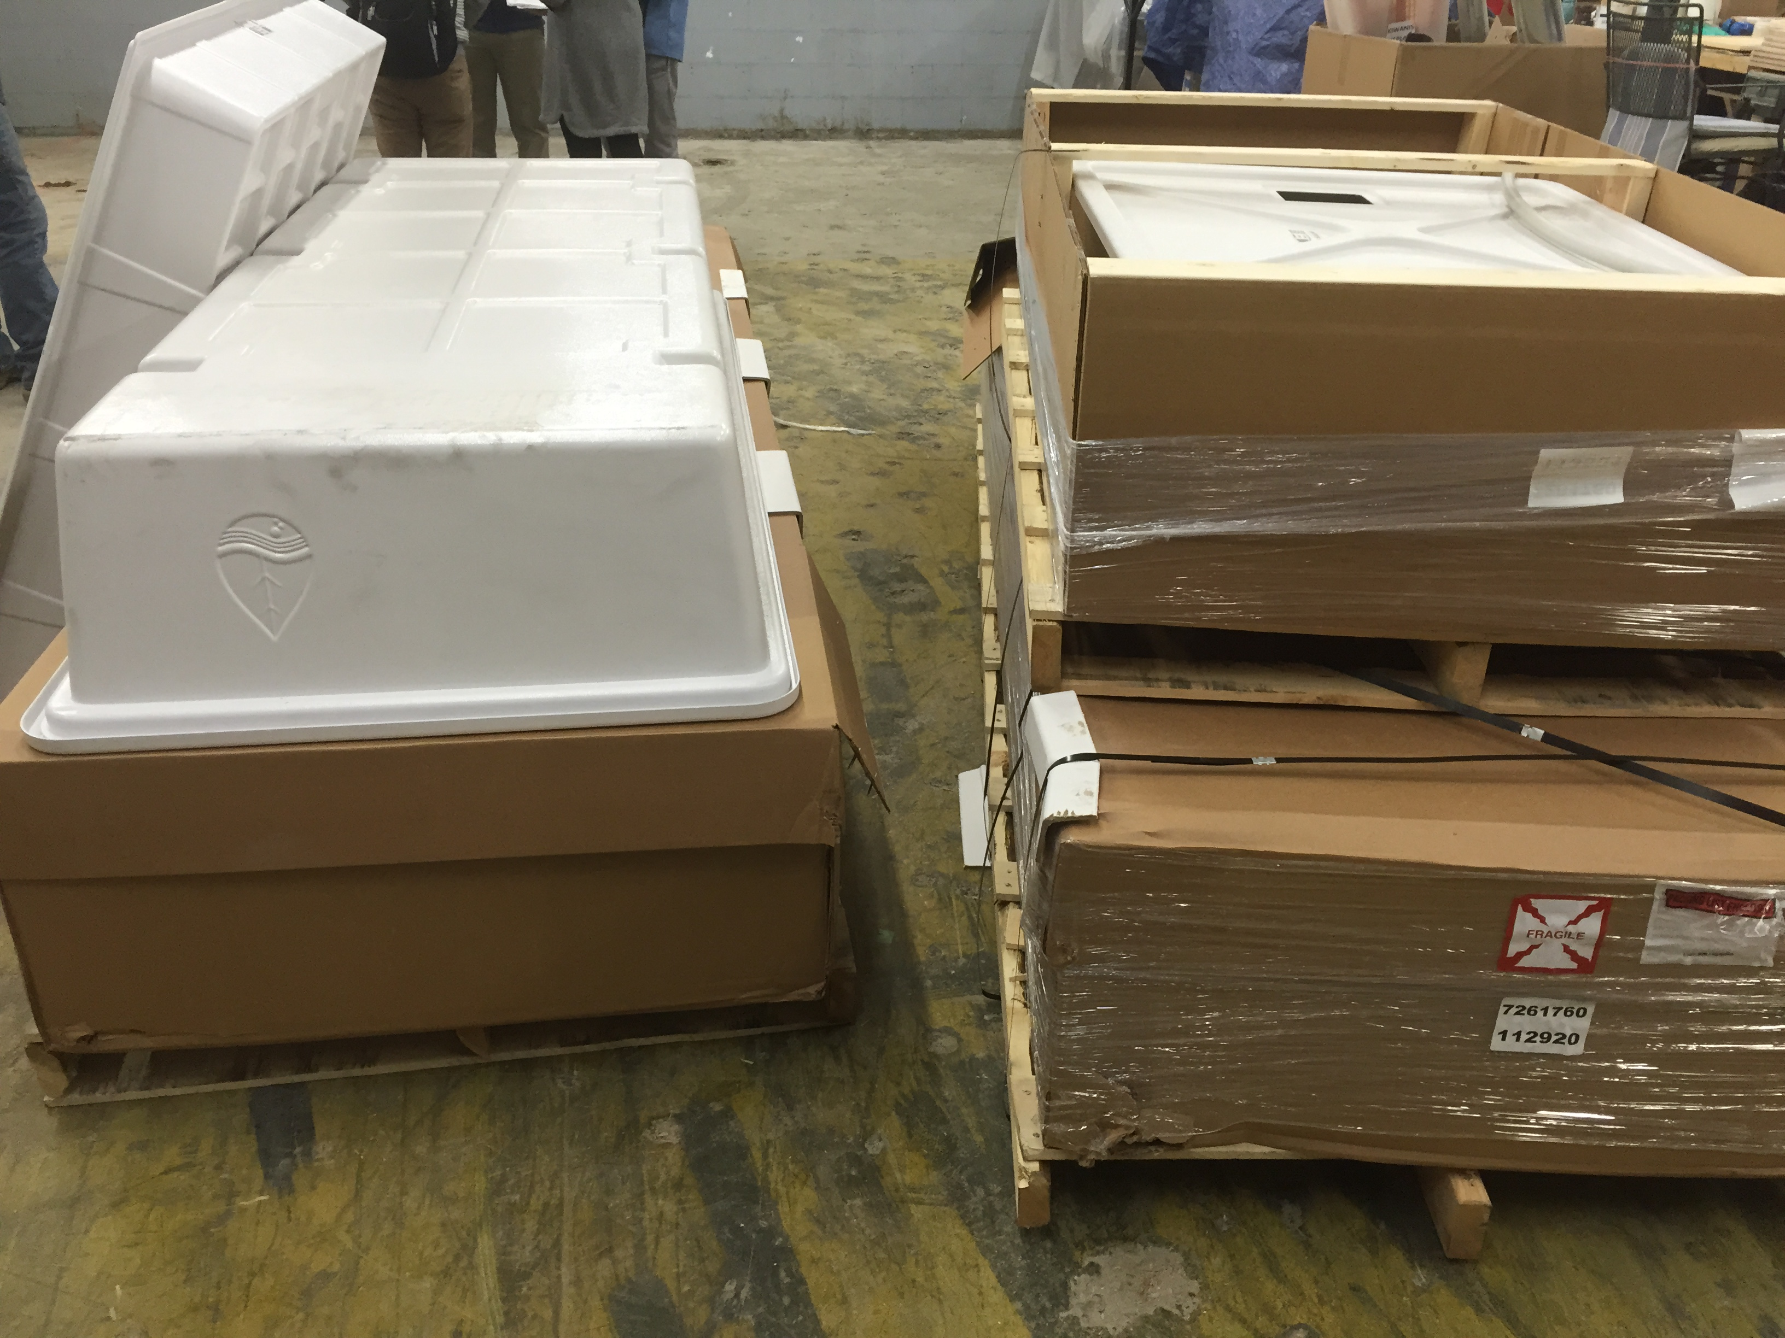
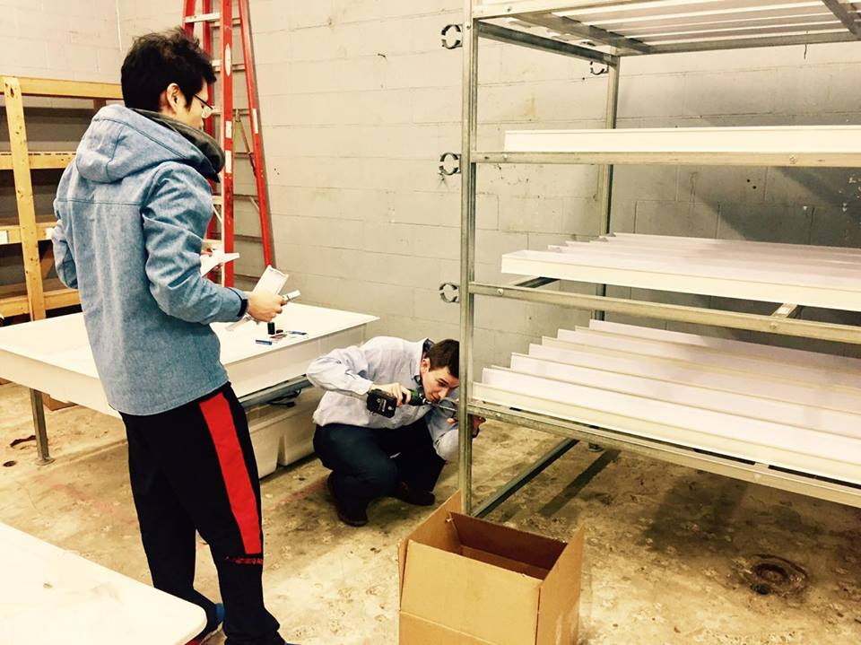
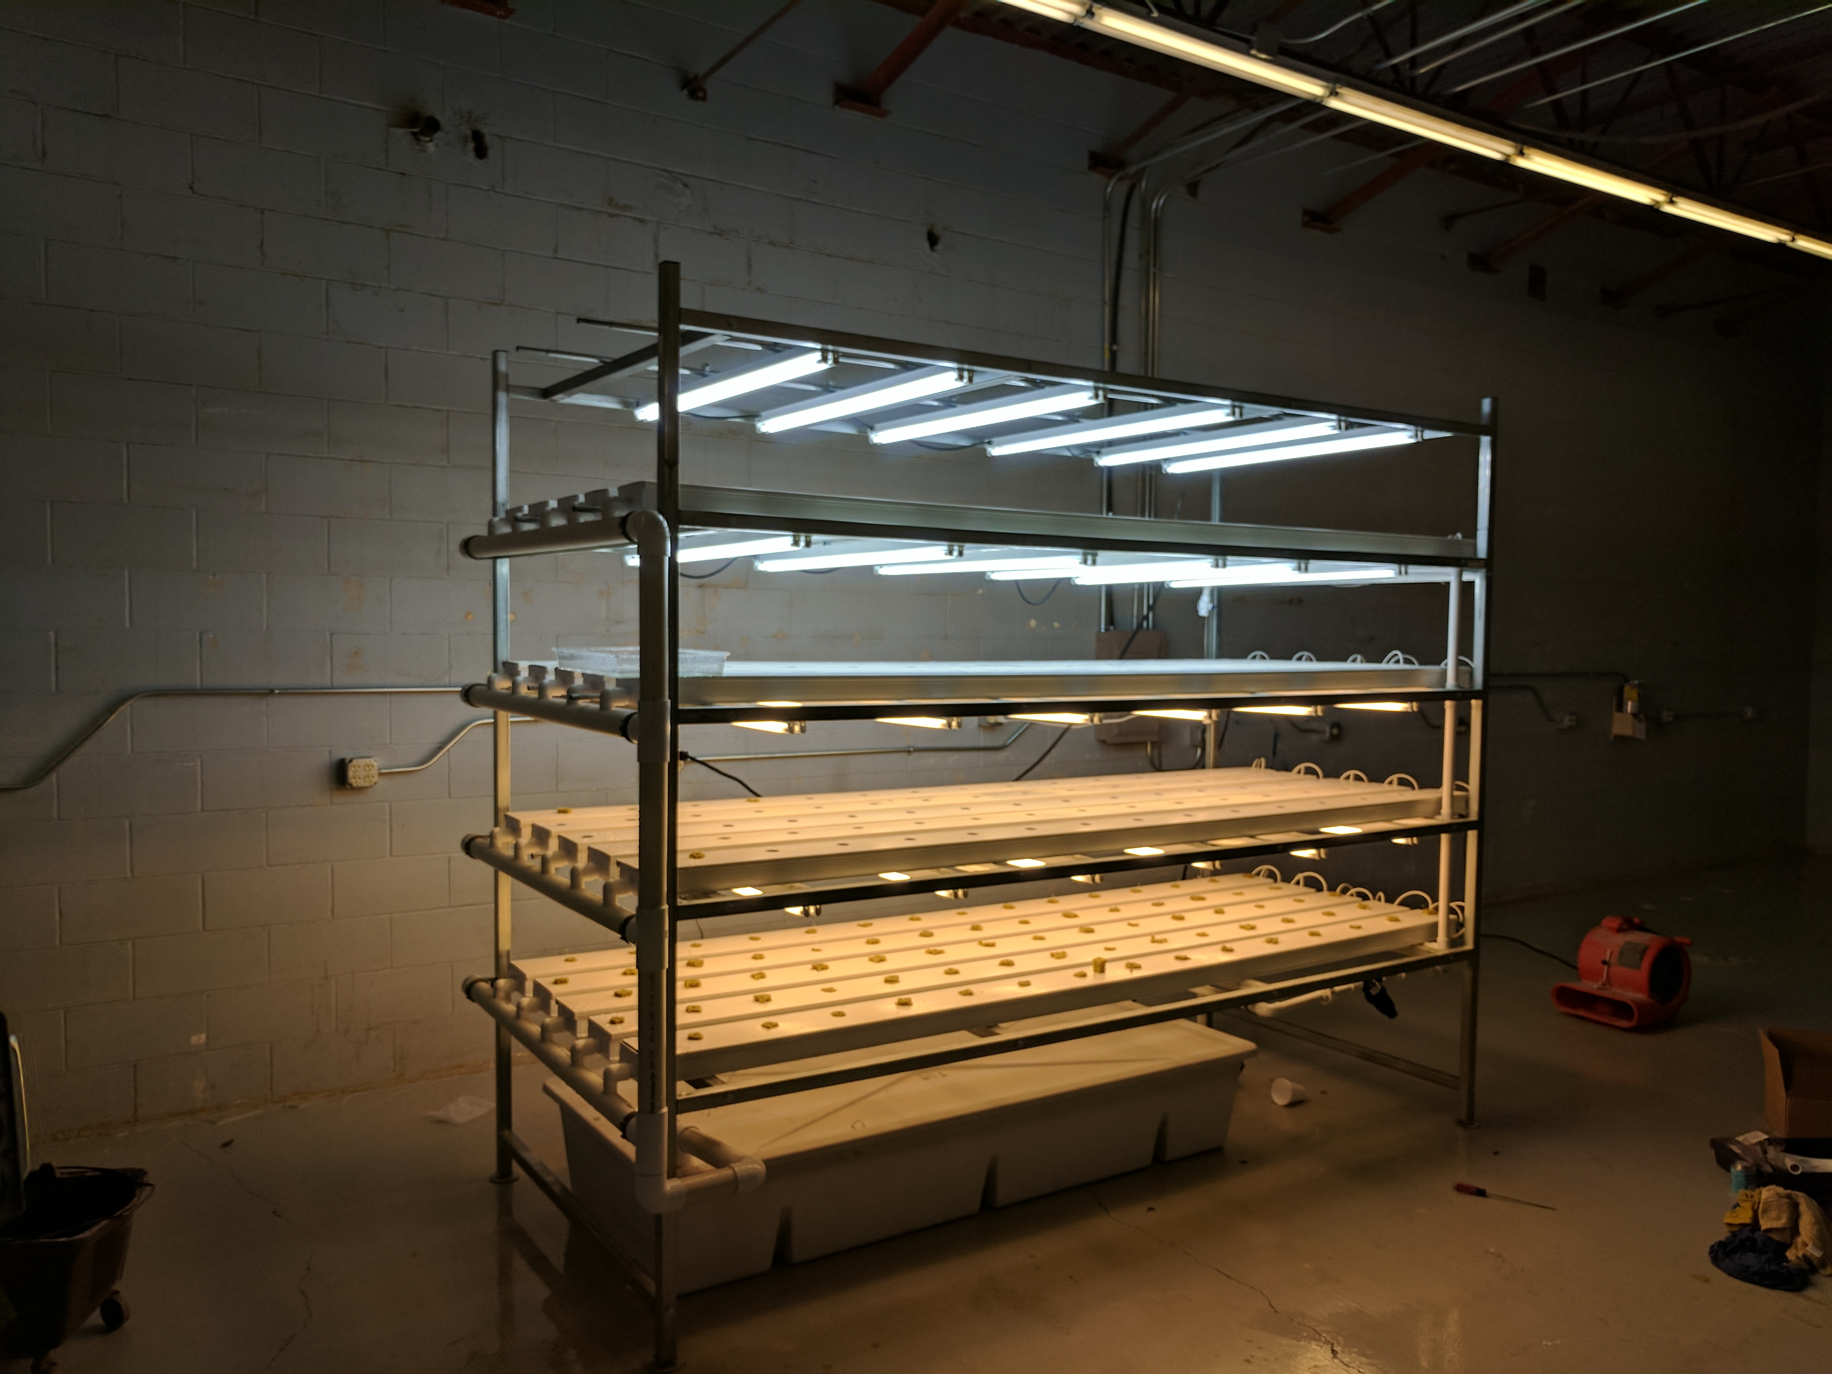
BIG WOW
Figure I. Hydroponics equipment and parts
Figure II. Construction of hydroponics equipment from scratch
Figure III. Completed setup of the Hydroponics equipment
Notes:
Marcos

Slide 6
OVERALL IMPACT
Unique Learning Opportunities
Food for Janus Cafeteria
Hydroponics is a popular and complex task that is a platform for learning and applying new concepts.
The lettuce being grown will serve as food for the Janus on-site cafeteria.
Better Workspace Utilization
We turned an some unused storage area into a space for growing the hydroponic plants.
Connection to Resources
We applied and received a $3000 Purdue- funded grant for the project. We also connected Janus to the Purdue Horticulture department to leverage all of the resources.
New Job Opportunities
Hydroponic plant growth will be another job that Janus can provide to clients.
Figure 4. Overall Impact at glance
Notes:
Marcos

Slide 7
PROJECT BACKGROUND
Notes:
Raghav

Slide 8
STATEMENT OF NEED
II. WORK INSTRUCTIONS
I. WORKSTATION SETUP
WORKSTATION
SETUP
SITE SELECTION
WORK INSTRUCTIONS
Full assembly of a 4 feet Ebb and Flo system and a 10 feet NFT system
Instructions and directions to complete daily processes of growing crops
III. VALUE STREAM MAPPING
IV. CROP SELECTION
Flow of materials from supplier of lettuce seeds to customers and consumers of the final product (crops)
CROP SELECTION
VALUE STREAM MAPPING
Determining the best crop that is cheap, easy to grow and has a higher yield
Figure 5. Statement of need
Notes:
Raghav

Slide 9
PHASE I: INFORMATION GATHERING
Site Selection
Crop Selection
Hydroponics Workshop at Purdue
Interview with Hydroponics experts
01
02
03
Notes:
Raghav

Slide 10
PHASE II: CONSTRUCTION AND ASSEMBLY
01
Funding through Purdue Office of Engagement
Weekly visits to the client facility
Working with the Facilities Manager to build the setup
02
03

Slide 11
PHASE III: FUNCTIONAL SETUP
01
Germination and Hydroponic production
Economic comparison of different types of lettuce
Hierarchical task analysis
Value stream mapping
Nutritional tool and daily operator check list tool
02
03

Slide 12
APPROACH AND RESULTS

Slide 13
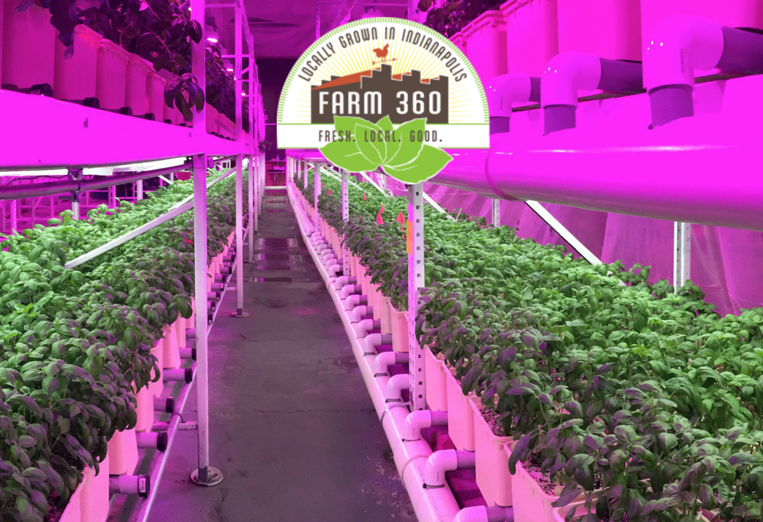
PHASE I: INFORMATION GATHERING
Meeting Janus – Establishing Relationships
Christine Sorensen, CEO
Jeff Newman, VP of Client Services
Jeff Shelly, Facilities Manager
Learning from Experts
Farm 360, Jim Bloom
Purdue Horticultural Department, Professor Nemali
Crop Selection - Lettuce
Location Selection
Notes:
Paulo

Slide 14
PHASE II: CONSTRUCTION AND ASSEMBLY - APPROACH
Funding:
1. Grant through Purdue Office of Engagement
Manufacturing Techniques:
Measurement
Tool Selection
Inspection
Procedure:
Weekly Site Visits for Assembly, Establishing Relationships
Jeff Shelly, Facilities Manager
Hands-On Construction Experience
Final Deliverable: Fully Functional Hydroponic System
Notes:
Everyone

Slide 15
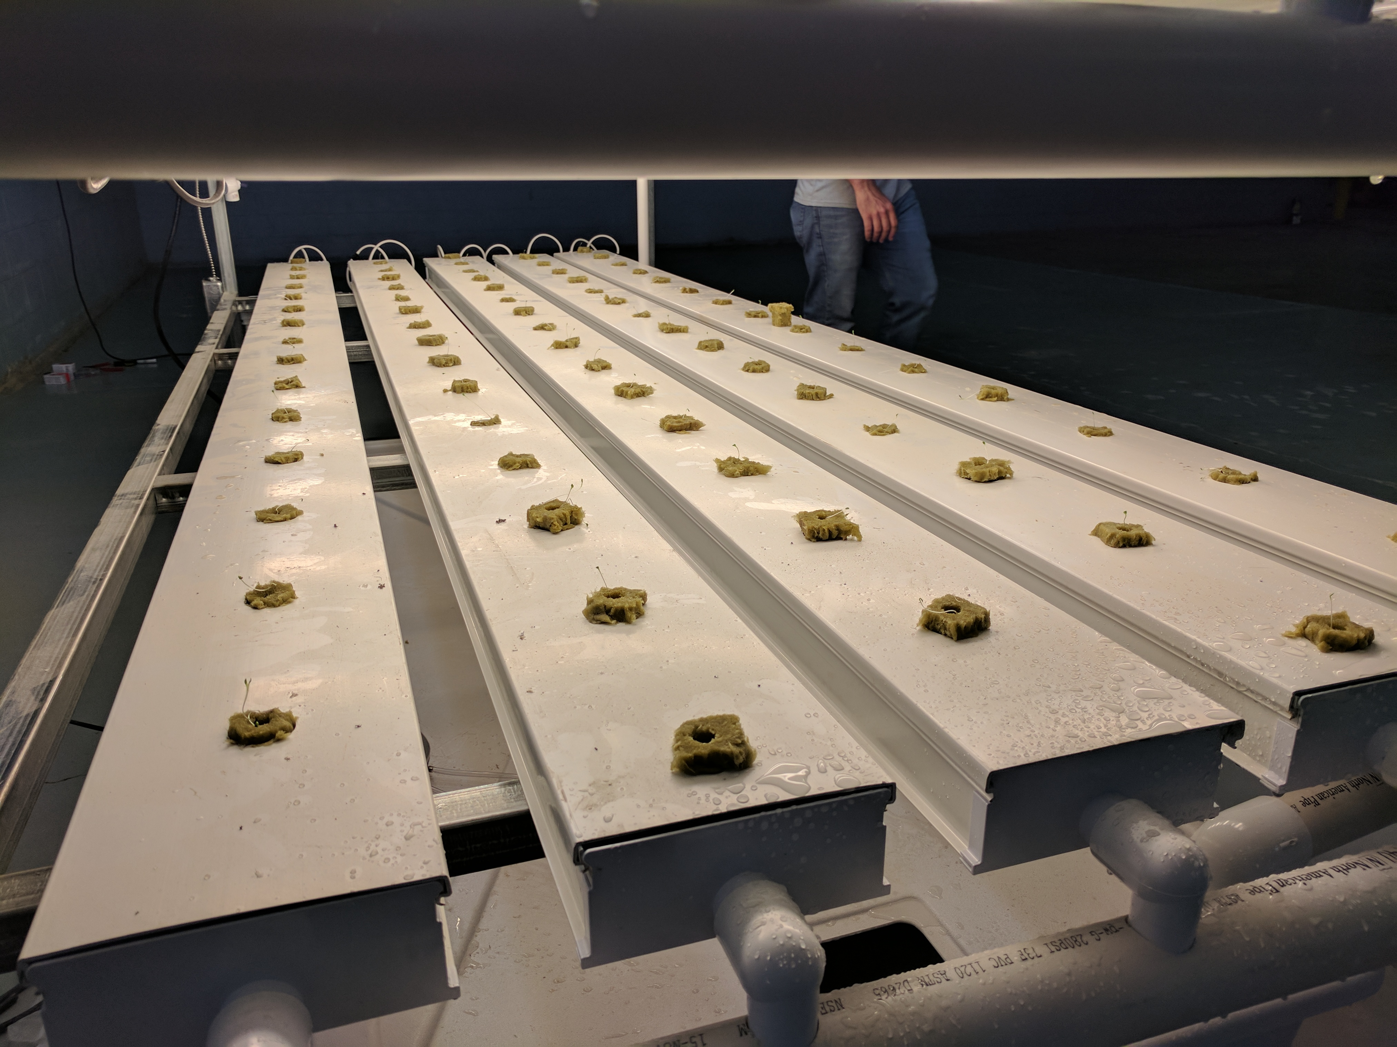
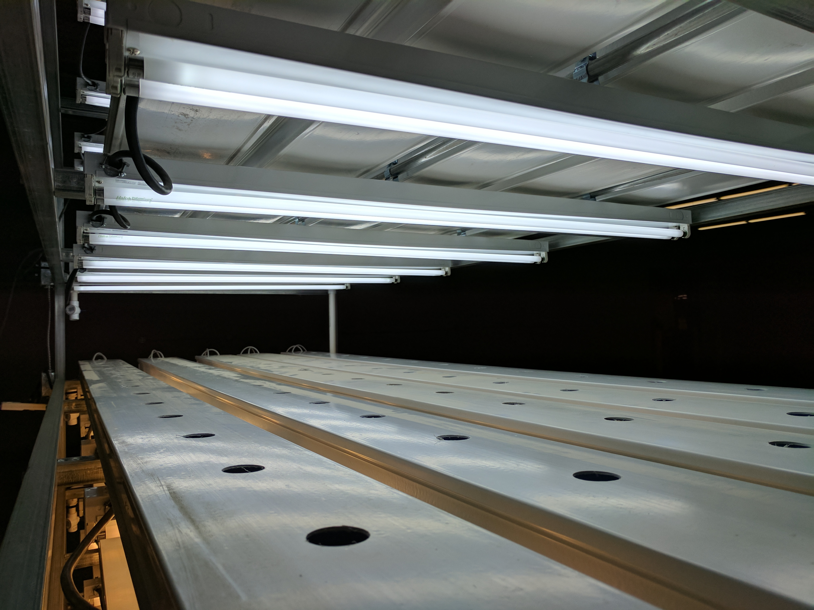
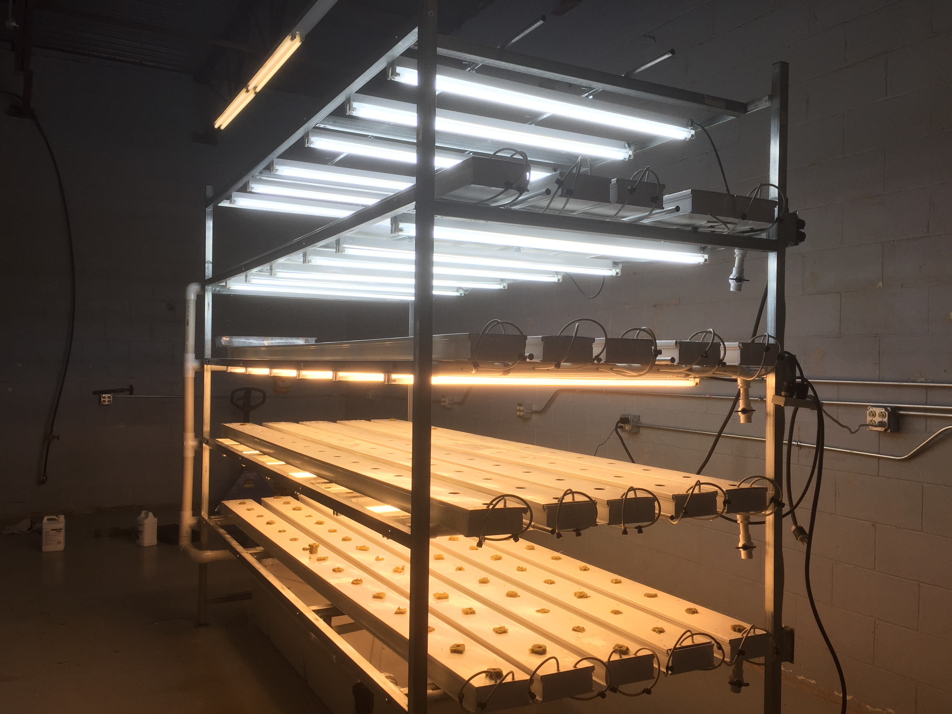
PHASE II: CONSTRUCTION AND ASSEMBLY – RESULTS
Figure 7. Plumbing system
Figure 8. Electrical (lighting) system
Figure 9. Overall hydroponics system

Slide 16
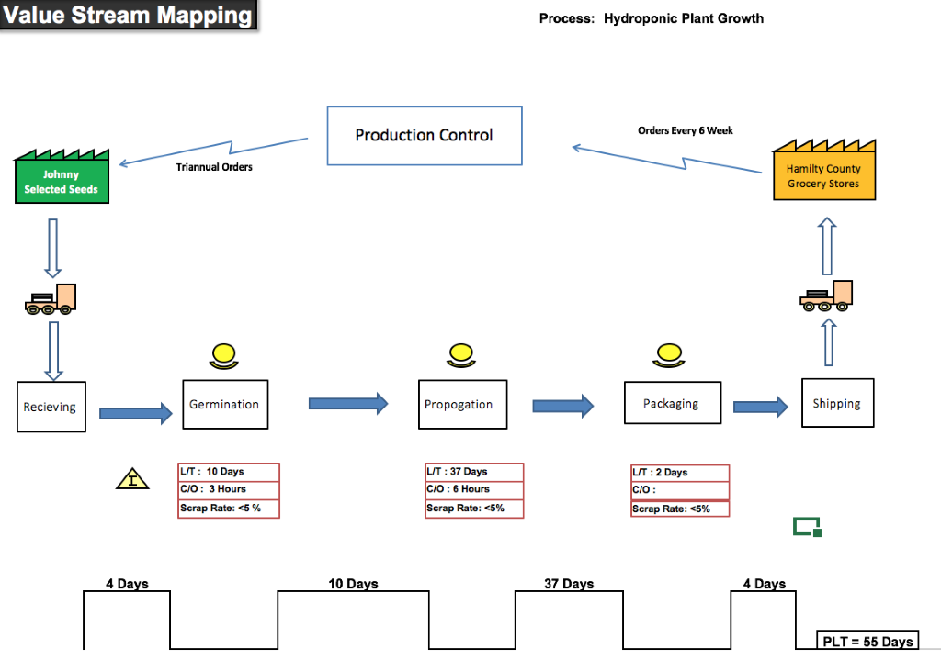
PHASE III: VALUE STREAM MAPPING – APPROACH AND RESULTS
Approach
Overarching goal of the project
Creating a sustainable and feasible system
Results:
Frequency of ordering seeds from supplier: Triannually*
Orders from customers: Every 6 weeks
Lead Time: 55 days
Production Capacity: 1600 9 oz bags/ 6 weeks
Figure 10. Value Stream Map
*Calculations in appendix
Notes:
Marcos

Slide 17
PHASE III: NUTRITION TOOL - APPRAOCH
Tool to calculate nutrition (sodium, potassium, phosphorous) and amount of water used by crops
Helps estimate amount of fertilizer need in the future based on dry weight
Specifications based on research efforts from Purdue Department of Horticulture
Helps Janus in performing important calculations quickly and conveniently
Potassium
Nitrogen
Phosphorous
5%
4.5%
0.5%
Notes:
Raghav

Slide 18
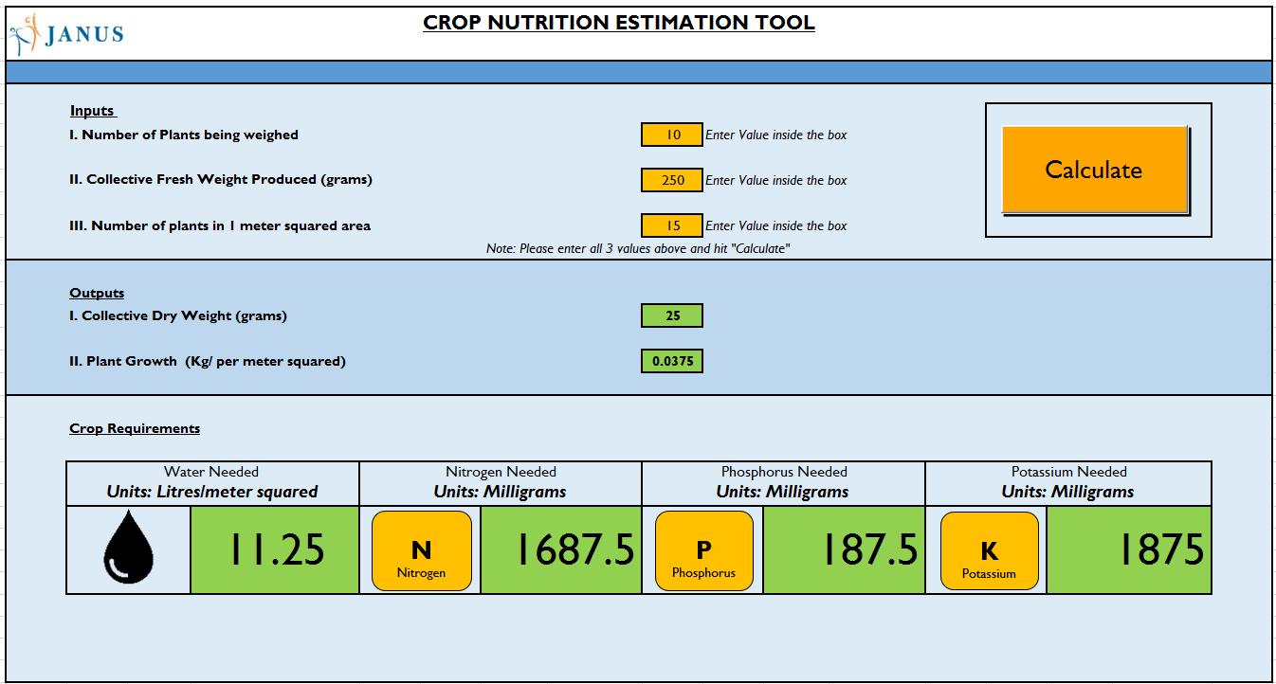
PHASE III: NUTRITION TOOL – RESULTS
Inputs
Number of plants being weighed
Collective Fresh Weight
Number of plants in 1 sq. meter
Outputs
Quantity of water needed
Amount of fertilizer needed
Figure 11. Nutrition Estimation Tool
Notes:
Raghav

Slide 19
PHASE III: HIERARCHICAL TASK ANALYSIS – APPROACH
Provide an understanding of cropping lettuce tasks Janus must perform to achieve the production of high quality of lettuce.
Divide the task into subtasks, subtask into elements and element into actions…
Analysis the hierarchical task performance and its effects to Janus workers.
Notes:
Paulo

Slide 20
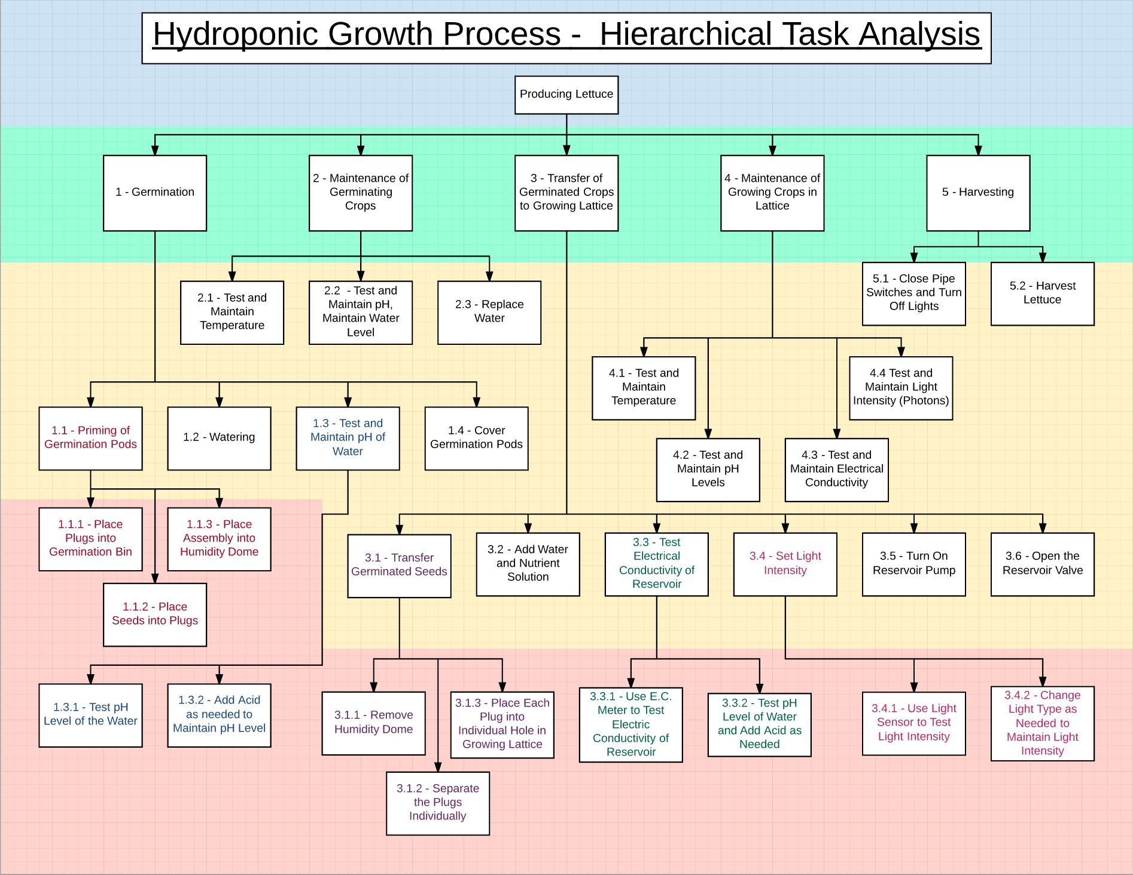
PHASE III: HIERARCHICAL TASK ANALYSIS – RESULTS
1. Differentiate different hierarchy task by different colors.
2. Detail the cropping steps Janus users must perform to accomplish their cropping goals
3. Based on the HTA, we build the user guide of cropping lettuce for Janus to train disable workers.
Notes:
Jianxing

Slide 21
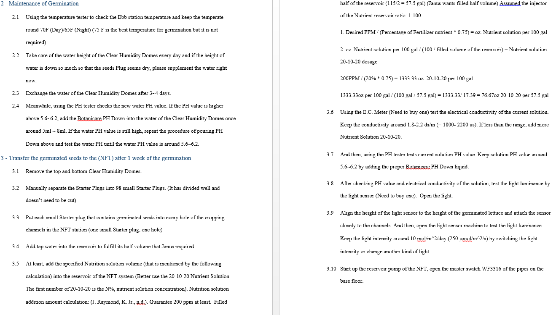
PHASE III: HIERARCHICAL TASK ANALYSIS – RESULTS
Create Step-by-Step user Guideline
See portion below.
Notes:
Jianxing

Slide 22
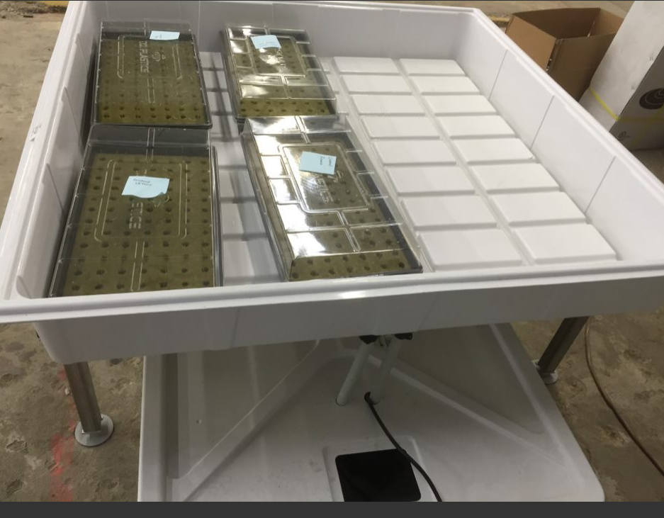
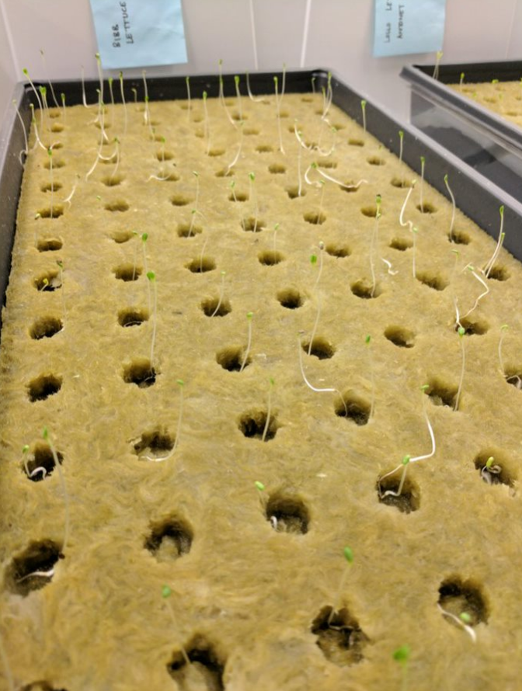
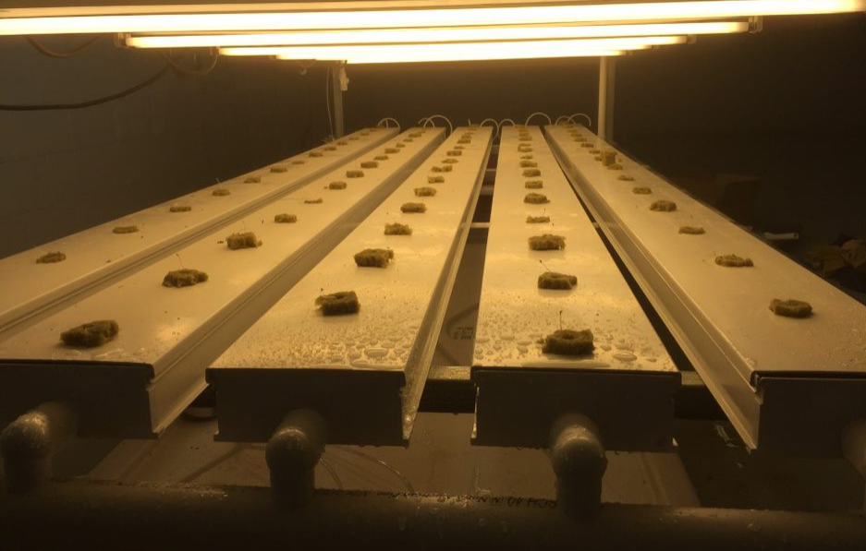
PHASE III: Operators Daily Checklist Tool – APPROACH
“Principle 14-4. Provide Job Performance Aids (JPAs) to ensure inspection procedures are properly followed”
Create daily checklists for both germination and hydroponics system
Notes:
Zening

Slide 23
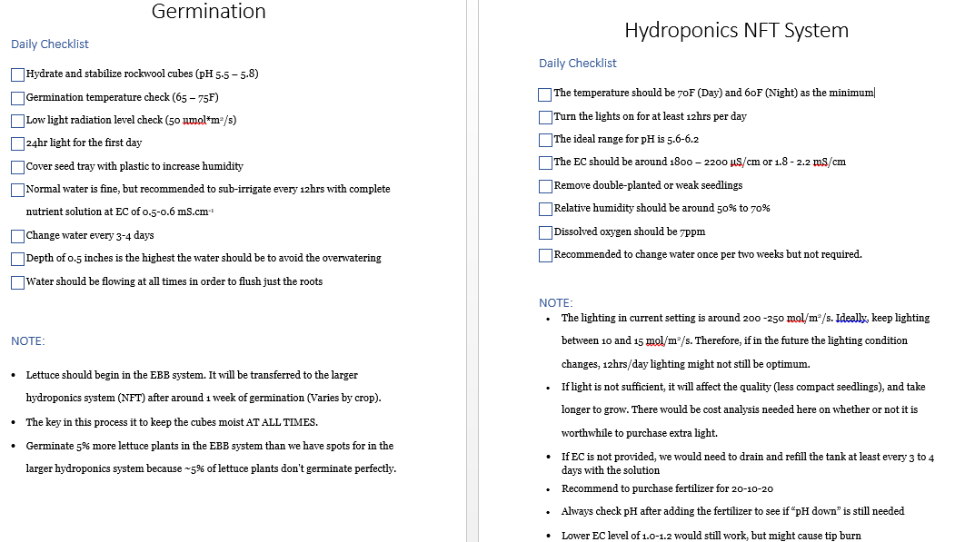
PHASE III: Operators Daily Checklist Tool – RESULTS
Provide the information most relevant to germination and hydroponics lettuce production
Notes:
Jianxing

Slide 24
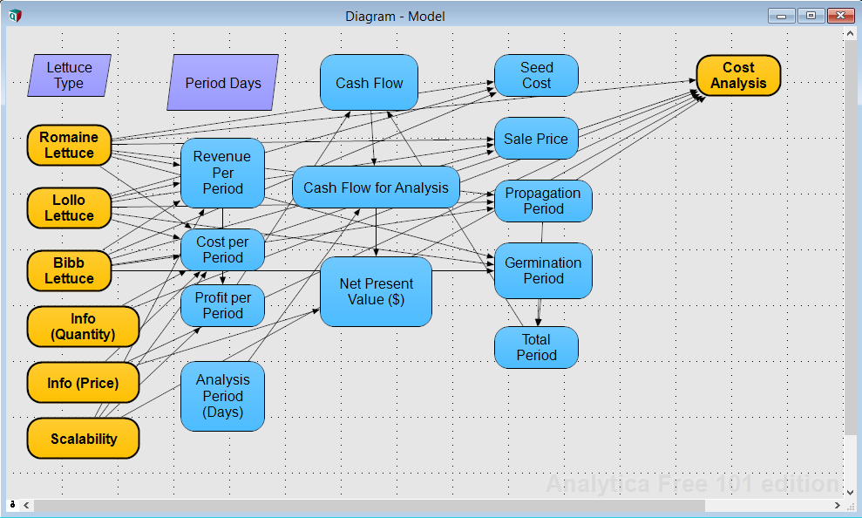
PHASE III: ECONOMIC ANALYSIS – APPROACH
“Time Value of Money”
Net Present Value (NPV)
Cash inflow includes:
Revenue
Cash outflow includes:
Electricity cost
Manpower
Fertilizer
Water
Seeds
Rockwool
Notes:
Zening

Slide 25
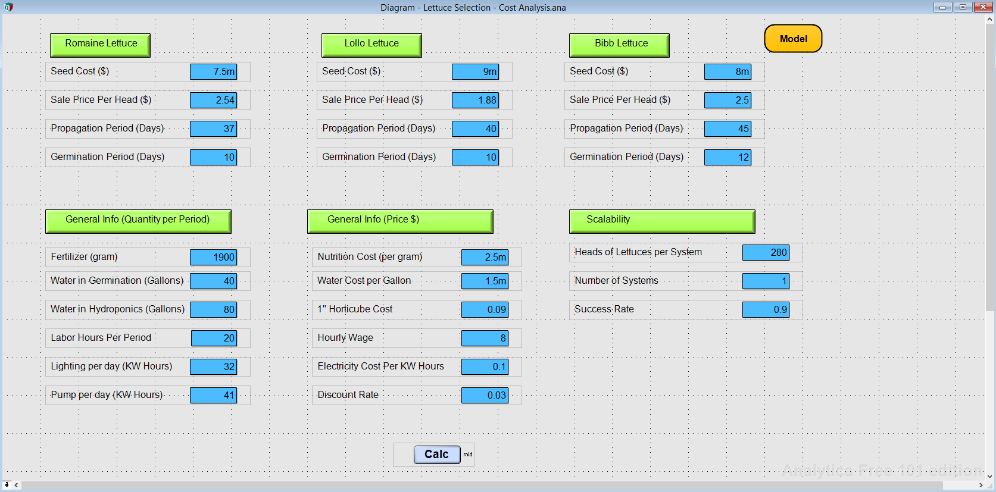
PHASE III: ECONOMIC ANALYSIS – RESULTS
User has the flexibility to change parameter in the future (eg. Scalability)
Notes:
Zening

Slide 26
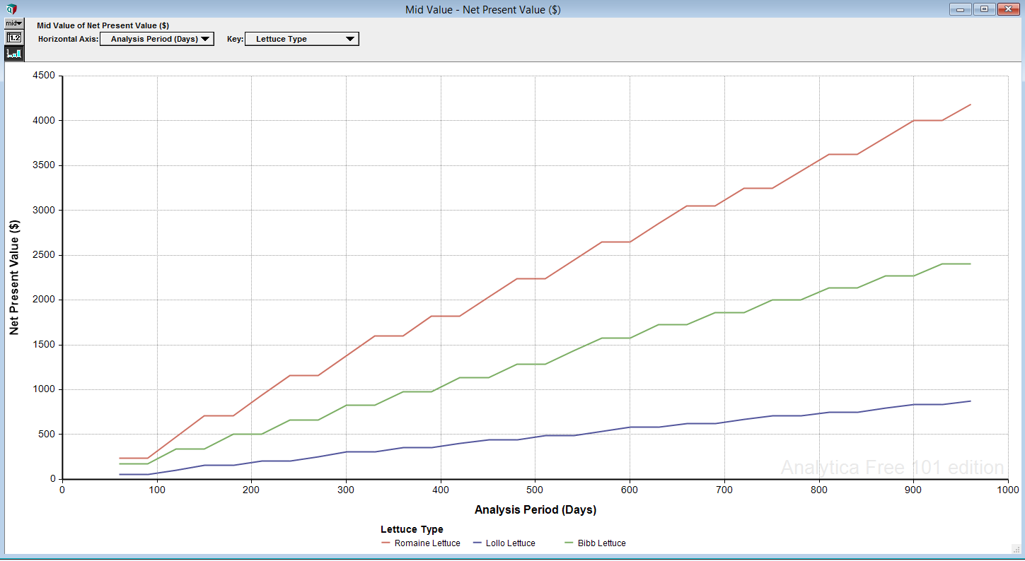
PHASE III: ECONOMIC ANALYSIS – RESULTS
Lettuce Selection and Projected Profitability based on the existing system → Romaine is the best choice.
Notes:
Zening

Slide 27
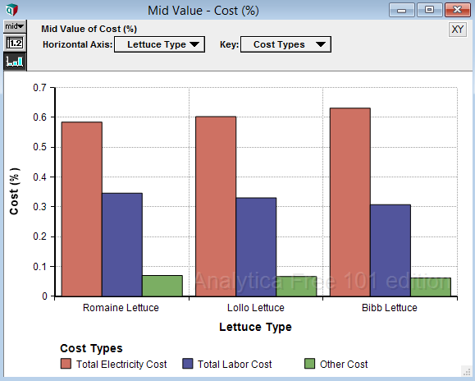
PHASE III: ECONOMIC ANALYSIS – RESULTS
Cost analysis to determine the selected tasks for continuous improvement (Pareto Principle)
Notes:
Zening

Slide 28
PROJECT MANAGEMENT

Slide 29
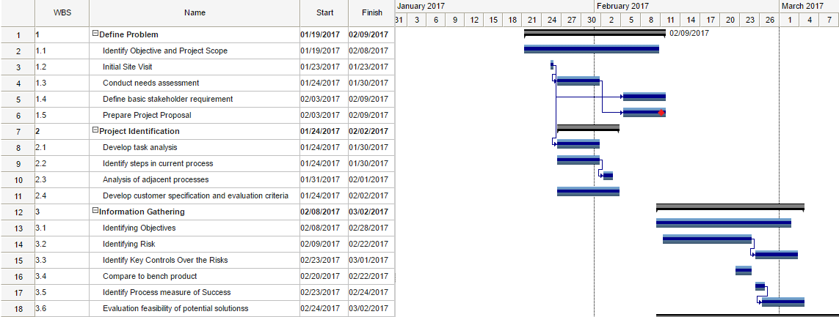
GANTT CHART – Phase I

Slide 30
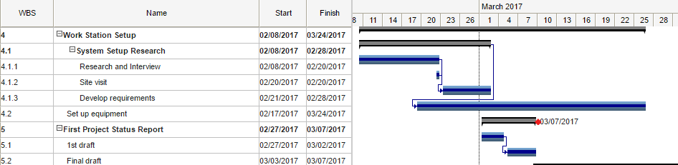
GANTT CHART – Phase II

Slide 31
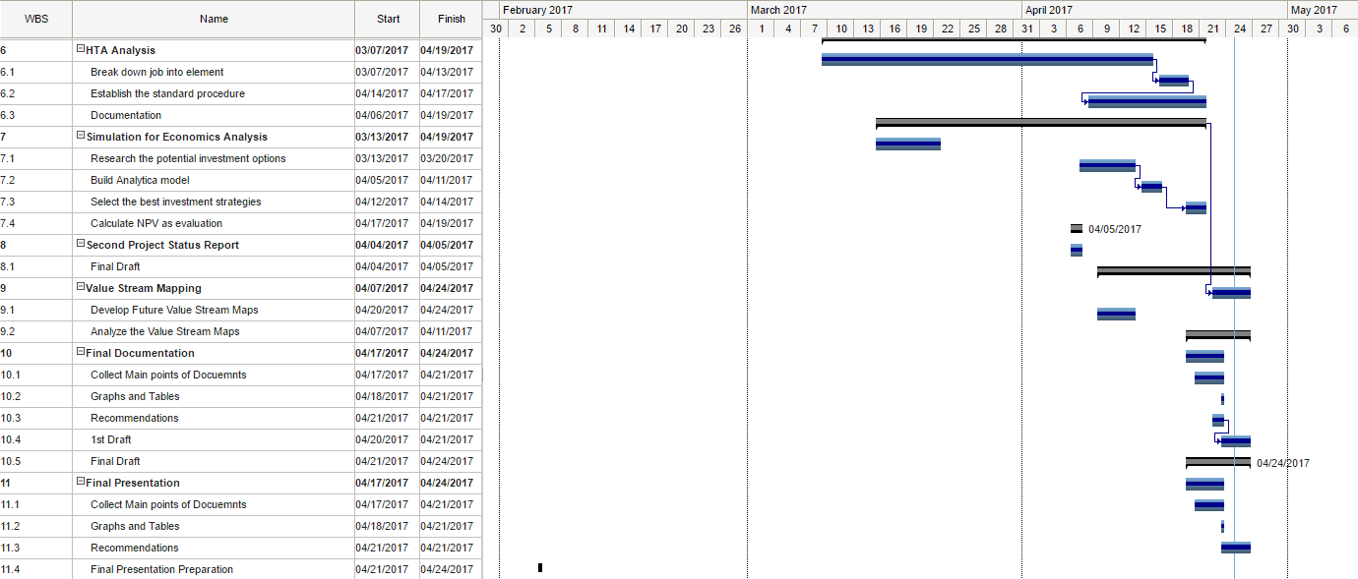
GANTT CHART – Phase III

